Slide 1
Homework 2
(11/21 due)

Slide 2
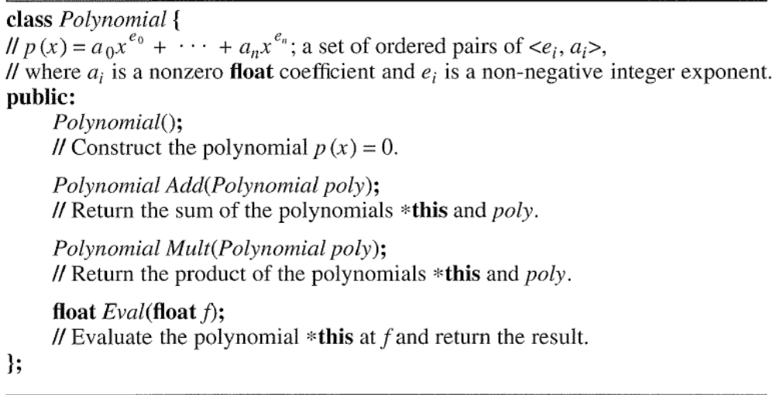
Homework 2 (11/21 due)
Figure 1. Abstract data type of Polynomial class

Slide 3
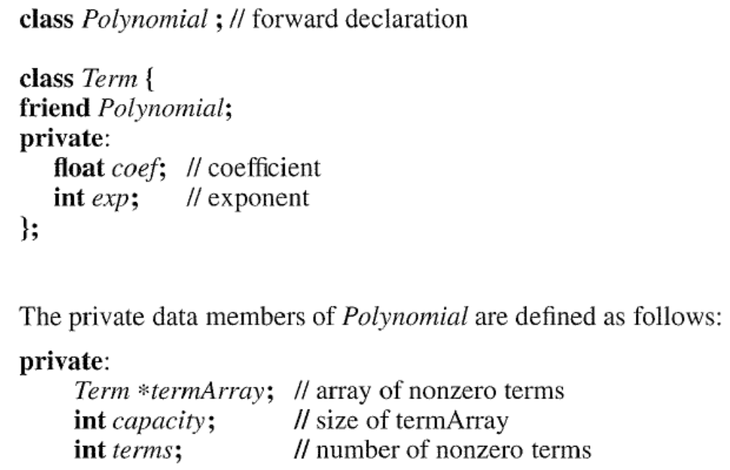
Figure 2. The private data members of Polynomial class

Slide 4
Problems
Implement the Polynomial class its ADT and private data members are shown in Figure 1 and 2, respectively.
Write C++ functions to input and output polynomials represented as Figure 2. Your functions should overload the << and >> operators.

Slide 5
作業繳交規範
解題說明 10%
  想法(How to do?)陳述，並舉例說明。
Algorithm Design & Programming 40%
  Source code + Comment
效能分析)Analysis) 15%
  Time complexity & Space complexity
測試與驗證(Testing and Proving ) 15%
效能量測 (Measuring) 10%
心得討論 10%

